Slide 1

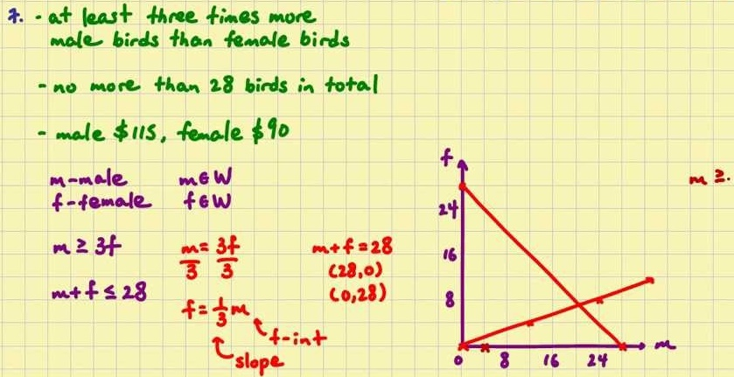
Mathematics (9-1) - iGCSE
2018-20
Year 07
Units 9-12 – Graphs, Transformations, Ratios, Right-Angles Triangles

Slide 2
Contents
Page iv
9 Graphs 67
9.1 Coordinates 67
9.2 Linear graphs 68
9.3 Gradient 69
9.4 y = mx + c 70
9.5 Real-life graphs 71
9.6 Distance-time graphs 72
9.7 More real-life graphs 74
9 Problem-solving 75
10 Transformations 77
10.1 Translation 77
10.2 Reflection 78
10.3 Rotation 79
10.4 Enlargement 80
10.5 Describing enlargements 81
10.6 Combining transformations 82
10 Problem-solving 83
11 Ratio and proportion 85
11.1 Writing ratios 85
11.2 Using ratios 1 85
11.3 Ratios and measures 86
11.4 Using ratios 2 87
11.5 Comparing using ratios 88
11.6 Using proportion 90
11.7 Proportion and graphs 90
11.8 Proportion problems 92
11 Problem-solving 92
12 Right-angled triangles 94
12.1 Pythagoras' theorem 1 94
12.2 Pythagoras' theorem 2 95
12.3 Trigonometry: the sine ratio 1 96
12.4 Trigonometry: the sine ratio 2 97
12.5 Trigonometry: the cosine ratio 98
12.6 Trigonometry: the tangent ratio 99
12.7 Finding lengths and angles using
trigonometry 101
12 Problem-solving 102

Slide 3
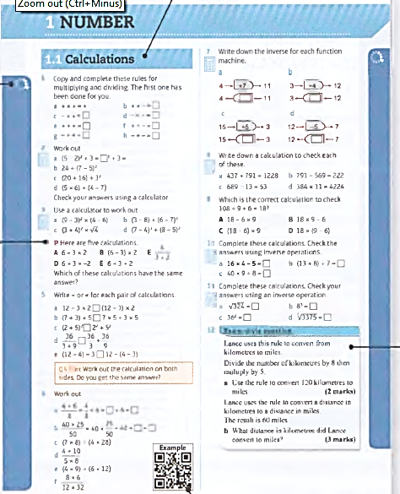
Contents
Page v
Icons alongside the questions show their level of difficulty. Questions in this book will range from 2
to 8
There is a section relating to every mastery lesson in the Student Book
This Practice Book is packed with extra practice on all the content of the Student Book - giving you more opportunities to practise answering simple questions as well as problem-solving and reasoning ones.
The letters P and R are used to show where a question requires you to problem- solve or reason mathematically- essential skills for your GCSE.
Exam-style questions are included throughout to help you prepare for your GCSE exam.
QR codes link to worked examples from the Student Book which will help you with the question they are alongside.

Slide 4
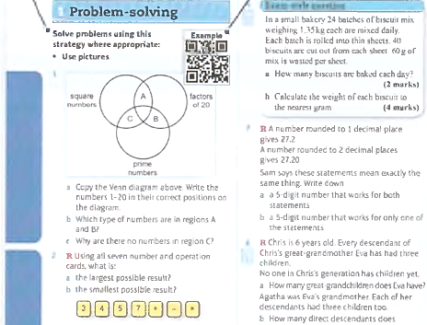
Contents
Page vi
These are strategies that you have learned so far in the Student Book. They build up as you work through the book. Consider whether they could help you to answer some of the following questions.
A QR code is given in the problem solving section where you learn a new strategy in that unit in the Student Book. Scan it to see the worked example and remind yourself of the strategy.
The R symbol indicates questions where you are required to reason mathematically. Questions in this section do not have the P symbol as they are all problem-solving.

Slide 5
9.1 – Coordinates
Page 67
a Angie uses this rule to generate coordinates.
The x-coordinate is always 3, no matter what the y-coordinate is.
Which of these coordinate pairs satisfy Angie's rule?
(3, 2), (-3, 5), (0, 3), (3, 3), (4, 3), (-1.3), (3,-2)
Draw a coordinate grid from -5 to +5 on both axes. Plot the points from part a that satisfy Angie's rule.
What do you notice about the points you have plotted?
Henry uses this rule to generate coordinates.
The x-coordinate is always 5, for any y-coordinates. Henry generates the coordinates (5, 2), (5,-1), (5,0) and (5, 4).
Where do you expect these points to be on the grid?
Plot the points on the same grid. Were you correct?

Slide 6
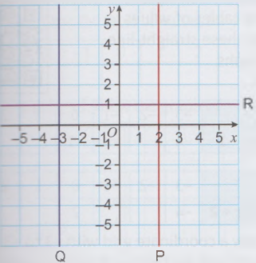
9.1 – Coordinates
Page 67
a Write down the integer coordinates of five points on line P.
What do you notice about the coordinates on line P?
Copy and complete.
The equation of line P is x = ...
The equation of line Q is x = ...
The equation of line R is y = ...

Slide 7
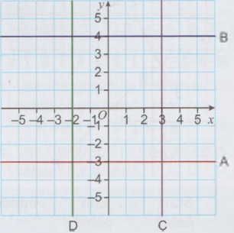
9.1 – Coordinates
Page 67
Write the equations of the lines labelled A, B, C and D.

Slide 8
9.1 – Coordinates
Page 67
R Draw a coordinate grid from -5 to +5 on both axes.
Draw and label these graphs.
y = 2
x = -1
y = -3
What is the equation of the y-axis?
Q4d hint - What is the x-coordinate of every point on the y-axis?

Slide 9
9.1 – Coordinates
Page 67
R a Write down the integer coordinates of the points on this line.
What do
you notice
about the
coordinates?
Complete the missing coordinates of these points on the line.
(6, □), (□ -8)
The equation of the line is y = ...

Slide 10
9.1 – Coordinates
Page 67
These points are on the line y = x.
(-3, -3), (-2, -2), (0, 0), (1, 1), (5, 5)
Draw a coordinate grid from -5 to +5 on both axes.
Plot the points and join them with a straight line.
Write the coordinates of three more points on the line y =x.

Slide 11

9.1 – Coordinates
Page 68
Find the midpoint of each of these line segments. Make a table to help you.
Line Segment | Start Point | End Point | Mid Point
AB | (2, 3) | (2, 5) | (2, 4)
CD
EF
GH
JK
LM
NP

Slide 12
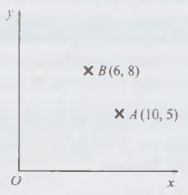

9.1 – Coordinates
Page 68
8 – Exam-Style Questions
The point A has coordinates: (10, 5).
The point B has coordinates: (6, 8).
M is the midpoint of AB.
Find the coordinates of M.
(3 marks)

Slide 13
9.1 – Coordinates
Page 68
Work out the midpoints of the line segments with these start and end points,
(1, 8) and (7, 4)
(1, 3) and (6, 8)
(-2, 5) and (4,1)
(-3, -7) and (0, -2)

Slide 14
9.2 – Linear Graphs
Page 68
This function machine generates coordinates, input function output coordinates
x y (x, y)
-2 □ (-2, □)
0 □ (0, □)
4 □ (4. □)
Work out the missing coordinates,
Draw a coordinate grid from -5 to +5 on both axes.
Plot the coordinates from part a on the grid.
Join the points and extend the line to the edges of the grid.
Write the coordinates of two more points that lie on the line.
Write a rule using algebra for this function machine.
Label your graph with this rule.
-3
Q1f hint - Your rule should start y = ...
What do you do to the x-value to get the y-value?

Slide 15
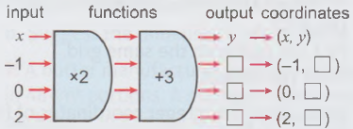
9.2 – Linear Graphs
Page 68
Repeat Q1 for this two-step function machine. Use a coordinate grid from -2 to 8 on both axes.

Slide 16
9.2 – Linear Graphs
Page 68
a Repeat Q1 for this two-
step function machine.
Use a coordinate grid
from -2 to 8 on both axes.
Draw a coordinate grid with -1 to 3 on the x-axis and -8 to +8 on the y-axis.
Draw and label the graphs of y = x - 1 and y = 2x + 2, using your tables of values from part a.
X | -3 | -2 | -1 | 0 | 1 | 2 | 3
y = x + 1 |  |  |  | -1
X | -3 | -2 | -1 | 0 | 1 | 2 | 3
y = 2x + 2 | -4 |  |  | 2

Slide 17
9.2 – Linear Graphs
Page 69
Draw and label these straight-line graphs for x = -3 to +3.
Use a suitable coordinate grid,
y = 2x - 1 b y = 3x - 2
y = 4x - 5 d y = 0.5x - 3
a Copy and complete these tables of values for straight-line graphs.
X | -3 | -2 | -1 | 0 | 1 | 2 | 3
y = -x – 2 | 1 |  |  | -2
X | -3 | -2 | -1 | 0 | 1 | 2 | 3
y = -2x + 1 | 7 |  |  | 1 |  |  | -5
X | -3 | -2 | -1 | 0 | 1 | 2 | 3
y = -3x + 2 | 11 |  |  | 2 |  |  | -7

Slide 18
9.2 – Linear Graphs
Page 69
b Draw a coordinate grid with -3 to +3 on the x-axis and -11 to +11 on the y-axis.
Draw and label the graphs of y = -x - 2, y = -2x + 1 and y = -3x + 2, using your tables of values from part a.
X | -3 | -2 | -1 | 0 | 1 | 2 | 3
y = -x – 2 | 1 |  |  | -2
X | -3 | -2 | -1 | 0 | 1 | 2 | 3
y = -2x + 1 | 7 |  |  | 1 |  |  | -5
X | -3 | -2 | -1 | 0 | 1 | 2 | 3
y = -3x + 2 | 11 |  |  | 2 |  |  | -7

Slide 19
9.2 – Linear Graphs
Page 69
Draw and label the graphs of these straight lines on the same grid, for values of x from -4 to +4.
y = -2x + 2
y = -x – 1
y = -3x + 5
y = -4x + 7
Would you expect these graphs to slope upwards or downwards from left to right?
i y = 2x -8 ii y = -3x + 2

Slide 20
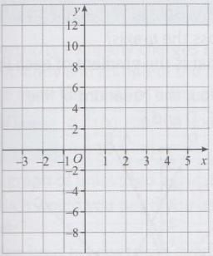
9.2 – Linear Graphs
Page 69
7 – Exam-Style Questions
Complete the table of values for y = 3x – 1
On the grid, draw the graph of y = 3x – 1
(4 marks)
x | -2 | -1 | 0 | 1 | 2 | 3 | 4
y

Slide 21
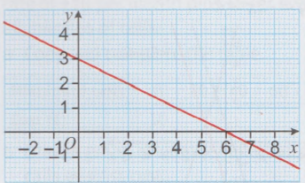
9.2 – Linear Graphs
Page 69
The diagram shows the graph of y = 3 – ½x
Use the graph to find an estimate for the value of y when
i x = 2.5 ii x = 6.8 iii x = -1.2
Use the graph to find an estimate for the value of x when
i y = 2.1 ii y = 0.4 iii y = -0.8
Use the graph to find approximate solutions to
these equations.
3.2 = 3 – ½x
1.7 = 3 – ½x
2.4 = 3 – ½x
Q8a hint - Find the point on the line where x = 2.5 and read across to the y-axis to find the value of y.

Slide 22

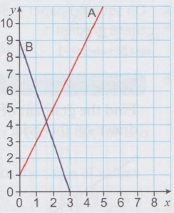
9.3 – Gradient
Page 69
Look at the graph.
How many squares does line A go up for every
  1 square across
  2 squares across
  3 squares across?
How many squares does line B go down for every
  1 square across
  2 squares across
  3 squares across?

Slide 23

9.3 – Gradient
Page 70
Here are the graphs of:
y = 3x - 2, y = 3x + 1 and
y = -3x + 4
Which two lines are parallel?
What are the gradients of the parallel lines?

Slide 24
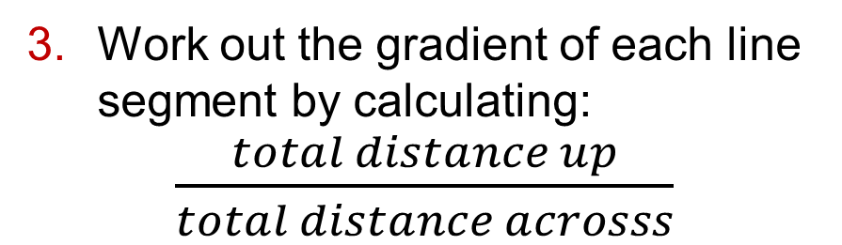
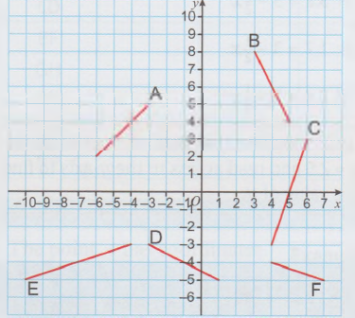
9.3 – Gradient
Page 70
Work out the gradient of each line segment by calculating:
$\frac{total distance up}{total distance acrosss}$

Slide 25
9.3 – Gradient
Page 70
On squared paper draw line segments with these gradients.
2 b -1 c -2 d ¼ e -½
5 – Exam-Style Questions
Find the gradient of the straight line drawn on this grid.
(2 marks)

Slide 26

9.3 – Gradient
Page 70
These sketches show ramps on an assault course. Work out the gradient of each ramp.
a Copy and complete these tables of values.
Draw the graphs of
i y = x - 2 ii y = 2x + l
Work out the gradient of each line.
X | -3 | -2 | -1 | 0 | 1 | 2 | 3
y = x – 2 | -5 |  |  | -2
X | -3 | -2 | -1 | 0 | 1 | 2 | 3
y = 2x + 1 | -5 |  |  | 1

Slide 27

9.3 – Gradient
Page 70
R Choose from these equations
the line with the steepest gradient
a pair of parallel lines
a line that slopes down from left to right.
Find the gradient of
the line joining the
points (3,1) and (7, 3).
y = 2x + 1 y = -3x - 2 y = -2x + 1
y = 4x – 3 y = x + 5 y = 2x - 3

Slide 28
9.4 – y = mx + c
Page 70
The diagram shows five straight-line graphs and their equations.
What do you notice about the equation of the line and the y-intercept?
Where would you expect y = -x + 4 to cross the y-axis?
What is the gradient of each line?

Slide 29

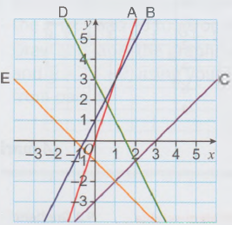
9.4 – y = mx + c
Page 70
Work out the equations
of lines A, B, C, D and E.

Slide 30
9.4 – y = mx + c
Page 71
Write down the equation of a straight line that is parallel to y = 3x - 4
Which of these lines pass through
  (1,1) b (0,-2)?
  In each of these you are given one point that lies on a line and the gradient of the line. Work out the equation of the line,
  (1, 2) and m = 2
  (3, 5) and m = 3
  (2,-1) and m = 1
  (-3,4) and m = ½
  (-3, -5) and m = 5
y = x y = x + 2 y = 2x
y = 2x – 2 y = x - 2 y = 2x - 1

Slide 31
9.4 – y = mx + c
Page 71
In each of these you are given two points that lie on a line.
Work out the equation of the line.
(1, 3) and (3, 7)
(2, 6) and (6, 8)
(1,1) and (3, -3)
(-2, 3) and (-5, 6)
Draw these graphs from their equations.
y = x - 5
y = -4x + 1
y = ½x + 2
y = -2x + 1

Slide 32
9.4 – y = mx + c
Page 71
Draw a coordinate grid from 0 to 8 on both axes. Plot these graphs.
  x + y = 3
  x + y = 5
  x + y = 2
  What do you notice?
Draw a coordinate grid from -8 to +8 on both axes. Plot these graphs.
2x + 3y = 6
y – x = 8
2x + 4y = 4
3x - y = 9

Slide 33
9.5 – Real-life Graphs
Page 71
P a An electricity company charges £0.10 per kWh unit. Copy and complete the table below to show the costs of using electricity.
Draw a graph of units used against cost, how much would you pay if you used 150 units?
Mr. Bridge buys his electricity in advance.
If he buys £20 worth and then uses 60 kWh units, how many units does he have left?
Number of Units | 0 | 100 | 200 | 300 | 400 | 500 | 600
Cost (£) | 10

Slide 34
9.5 – Real-life Graphs
Page 71
A mobile phone company charges a flat rate of £10 per month plus £5 for every 20 minutes of calls, a Copy and complete the table.
Draw a graph of number of minutes of calls against cost.
Anna's phone bill is £27. Use your graph to find the total length of calls she made.
Minutes of Calls | 0 | 20 | 40 | 60 | 80 | 100
Cost (£) | 10 |  |  |  |  | 35

Slide 35
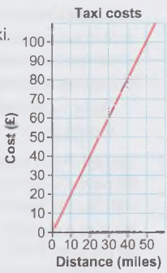
9.5 – Real-life Graphs
Page 71
R The graph shows the Taxi costs cost of travelling in a taxi
  What is the cost of
    a 50-mile journey
    a 10-mile journey?
  What is the gradient of the graph?

Slide 36
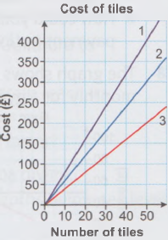
9.5 – Real-life Graphs
Page 71
R The graphs show the costs of tiles at three different DIY shops.
Store A Tiles £4 each
Store B Tiles £8 each
Store C Tiles £6 each
Match each line on the graph with the correct store,
Copy and complete this statement.
The steeper the slope the ____________ the unit price.

Slide 37
9.5 – Real-life Graphs
Page 71
R A plumber charges a £50 callout fee and £25 per hour.
Copy and complete the table of values.
Draw a graph of hours worked against total cost.
Work out the equation of the line.
What does the gradient represent?
What does the y-intercept represent?
Hours worked | 0 | 1 | 2 | 3 | 4 | 5
Total Cost (£) | 50 |  |  |  |  | 175

Slide 38
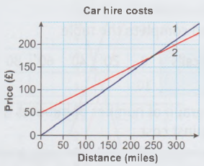
9.5 – Real-life Graphs
Page 72
R The graph shows the costs of two different car hire companies.
A2B Cars charge £50 flat rate and £0.50 per mile.
121 Cars charge £0.70 per mile,
Match each line on the graph with the correct car hire company,
Chaitaly is going on a 300-mile journey. Explain which car hire company she should use.

Slide 39
9.5 – Real-life Graphs
Page 72
Obalesh has a movie package on his television. He pays £15 per month plus £3 for each film he watches. He watches about 6 films a month.
He sees a new offer for £25 per month plus £1 per film.
Should he change to the new offer?
How could you see at a glance when each payment option was better value?

Slide 40
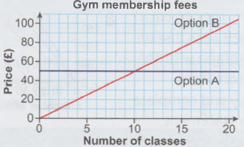
9.5 – Real-life Graphs
Page 72
The graph shows two different ways to pay monthly for a gym membership.
Explain in words what each option means.
Diccon expects to do approximately 15 classes a month. Which option should he choose?

Slide 41
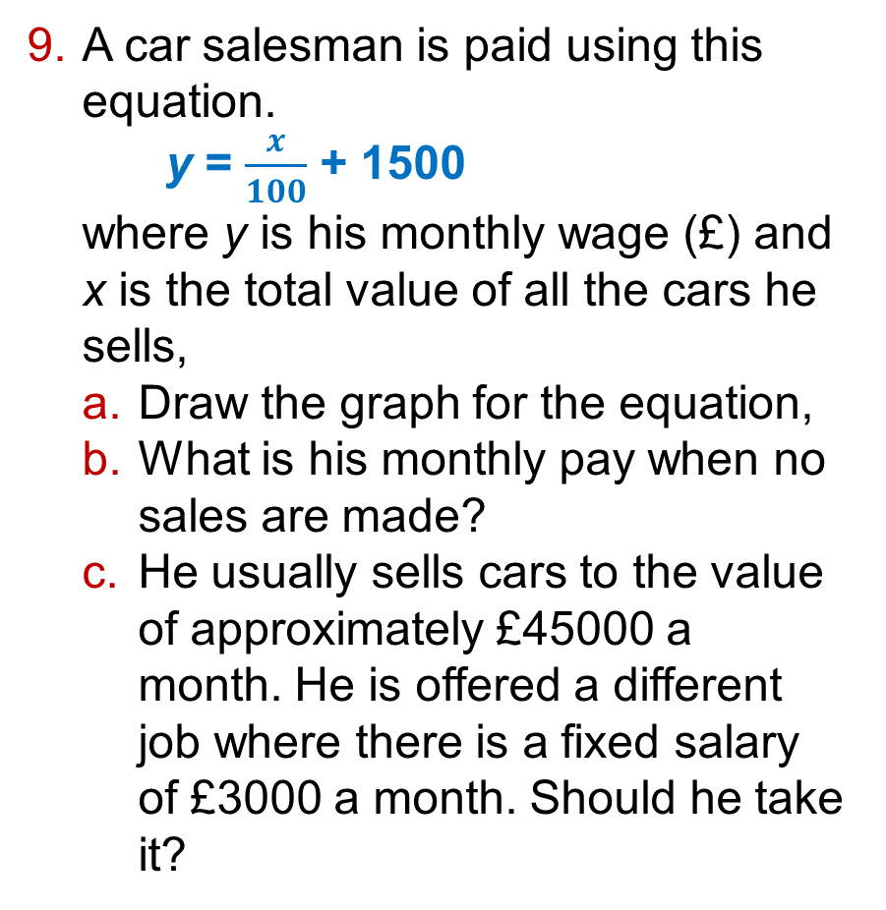
9.5 – Real-life Graphs
Page 72
A car salesman is paid using this equation.
y = $\frac{x}{100}$ + 1500
where y is his monthly wage (£) and x is the total value of all the cars he sells,
Draw the graph for the equation,
What is his monthly pay when no sales are made?
He usually sells cars to the value of approximately £45000 a month. He is offered a different job where there is a fixed salary of £3000 a month. Should he take it?

Slide 42
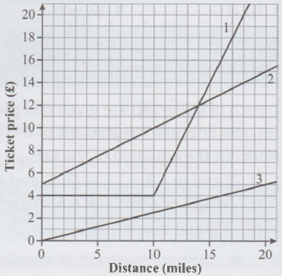
9.5 – Real-life Graphs
Page 72
10 – Exam-Style Questions
The graph shows how three different bus companies work out the cost of their tickets.
Here are the charges of the three companies.
Company A 25p per mile.
Company B £4 for all journeys up to 10 miles, then an extra £2 per mile.
Company C £5 plus 50p per mile.
Match each line on the graph to the letter
of the company it represents. Sanjit uses company B to travel 12 miles.
Find the total cost of a ticket.
Maarta needs to travel 15 miles. She can only use company B or C.
Explain which company would be cheaper for her to use. You must give reasons for your answer. (4 marks)
Exam hint - To get all the marks you need to refer to the numbers on the graph as you explain your reasons.

Slide 43
9.6 – Distance-time Graphs
Page 72
R Aaban leaves for school at 8 am. He walks for 1 mile to his friend's house, which takes him 20 minutes.
He then meets his friend at his house, stops for 10 minutes for a cup of tea, and walks a further j mile, which takes him 15 minutes,
  Draw a distance-time graph for Aaban's journey.
  Work out the average speed in miles per hour for each part of his journey.
  Compare the average speeds to decide in which part of the journey he was walking more quickly.
Q1a hint - Draw a horizontal axis from 0 to 60 minutes and a vertical axis from 0 to 2 miles.

Slide 44
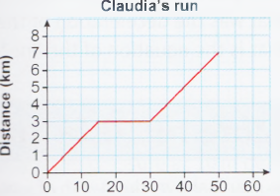
9.6 – Distance-time Graphs
Page 73
This distance-time graph shows Claudia's morning run.
How far did Claudia jog on the first part of the run?
How long did she jog for before she stopped for a break?
How long did she rest for?
What was her average speed in km/h for the first part of the run?
How long did the last
part of the run take?
How far did she jog on
the last part of the run?
What was her average
speed for the last part
of the run?

Slide 45
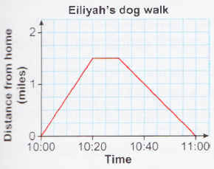
9.6 – Distance-time Graphs
Page 73
This graph shows Eiliyah's distance from home when walking her dog.
Work out the average speed of her walk for the first part of the journey.
How long did she stop for?
Work out the average speed on her return journey.
How far did she walk altogether?

Slide 46
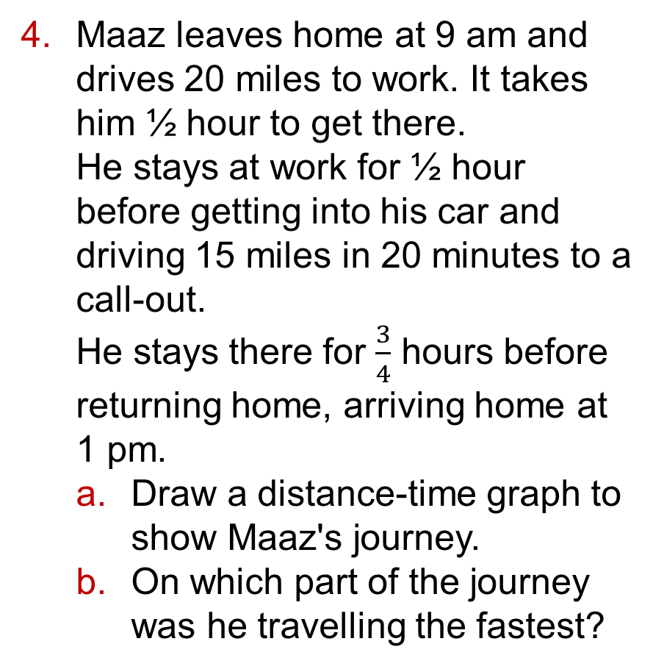
9.6 – Distance-time Graphs
Page 73
Maaz leaves home at 9 am and drives 20 miles to work. It takes him ½ hour to get there.
He stays at work for ½ hour before getting into his car and driving 15 miles in 20 minutes to a call-out.
He stays there for $\frac{3}{4}$ hours before returning home, arriving home at 1 pm.
Draw a distance-time graph to show Maaz's journey.
On which part of the journey was he travelling the fastest?

Slide 47
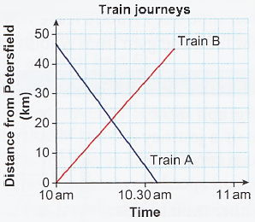
9.6 – Distance-time Graphs
Page 73
The graph shows two train journeys.
One train leaves Petersfield at 10am and travels to Guildford. The other train leaves Guildford at
10am and
travels to
Petersfield.
Which line shows the Guildford to Petersfield train?
What time does each train reach its destination?
Which train journey is faster?

Slide 48
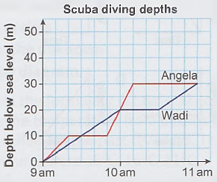
9.6 – Distance-time Graphs
Page 73
Angela and Wadi go scuba diving.
The graph shows their depths below sea level at
different
times.
What is the
maximum depth that they dive to?
How long does Wadi spend at 20 metres below sea level?
Between what times is Wadi deeper than Angela?
How long does it take Angela to reach her maximum depth?

Slide 49
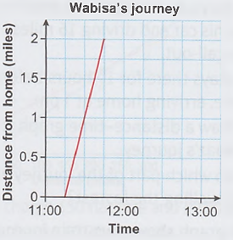
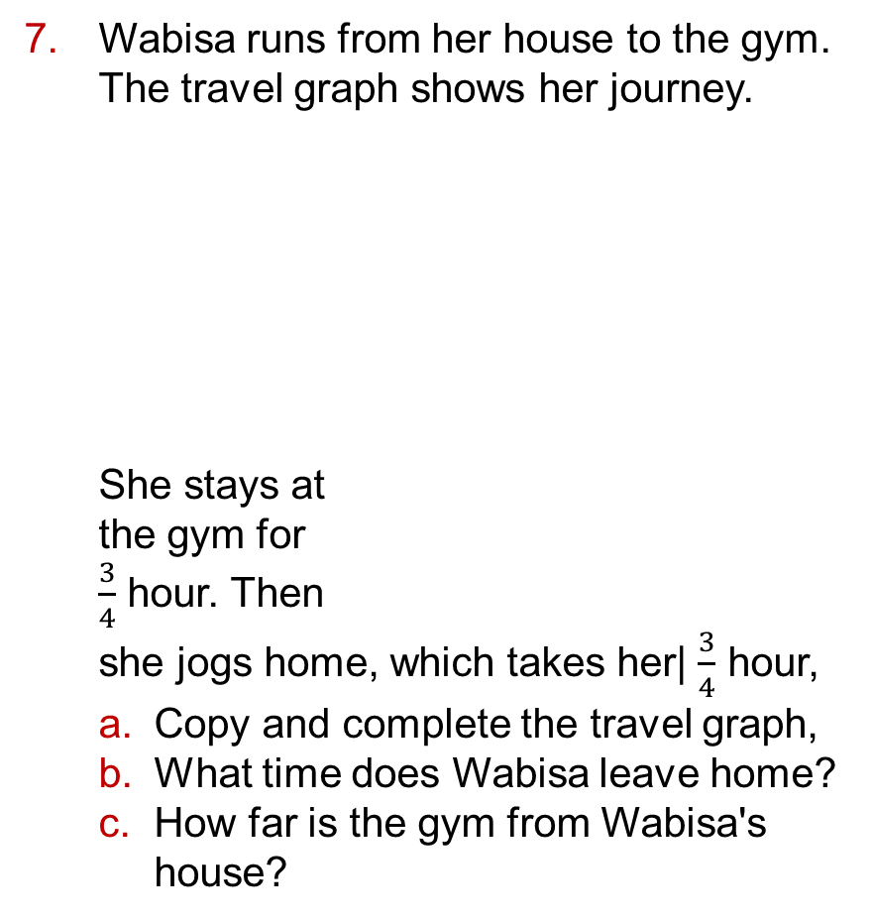
9.6 – Distance-time Graphs
Page 74
Wabisa runs from her house to the gym. The travel graph shows her journey.
She stays at
the gym for
$\frac{3}{4}$ hour. Then
she jogs home, which takes her| $\frac{3}{4}$ hour,
Copy and complete the travel graph,
What time does Wabisa leave home?
How far is the gym from Wabisa's house?

Slide 50
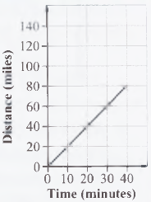
9.6 – Distance-time Graphs
Page 74
8 – Exam-Style Questions
The graph shows part of a journey of a train travelling at constant speed. Another train travels at a speed of 100 mph. Which train is faster? You must explain your answer. (3 marks)

Slide 51
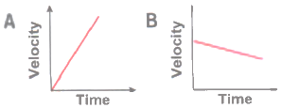
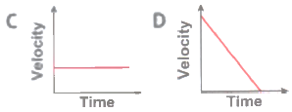
9.6 – Distance-time Graphs
Page 74
Match each of these velocity-time graphs to
one of the sentences.
Starts from rest and velocity steadily increases.
Travels at a steady velocity.
Velocity steadily decreases before stopping.
Steadily decreases in velocity.
Q9 hint - Velocity means speed in a particular direction.

Slide 52
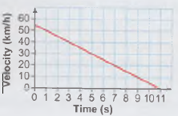
9.6 – Distance-time Graphs
Page 74
The graph shows the velocity of a car when it is braking.
What was the starting velocity of the car?
What was the deceleration of the car?
What is the equation of the line?

Slide 53
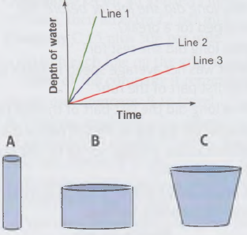
9.7 – More Real-Life Graphs
Page 74
R The graph shows the depth of water for three containers A, B and C, filling at a constant rate.
Which container will fill fastest?
Match each container to a line on the graph.

Slide 54

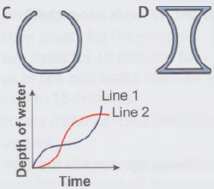
9.7 – More Real-Life Graphs
Page 74
P a Two baths A and B are filled with wat at a constant rate. Sketch a graph of depth of water against time for each the baths.
Two different
containers are
filled at a
constant rate.
Match each
container to
graph.

Slide 55
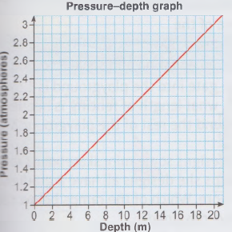
9.7 – More Real-Life Graphs
Page 75
The graph shows the pressure on your eardrums in atmospheres) at up to 20 m depth in water.
Estimate the pressure at 10 m depth.
Estimate the depth of water when the pressure is 1.2 atmospheres.
Rabail says, The rate of increase of pressure with depth is always the same'. What evidence from the graph supports this?
Work out the gradient of the line.

Slide 56
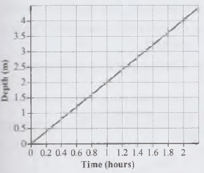
9.7 – More Real-Life Graphs
75
4 – Exam-Style Questions
Water fills a cuboid swimming pool at a constant rate. The graph shows how the depth of water in the pool varies over time.
Work out the gradient of the straight line.
Write down a practical interpretation of the value you worked out in part a (3 marks)

Slide 57

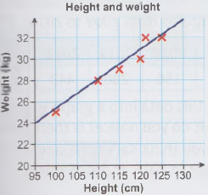
9.7 – More Real-Life Graphs
Page 75
P The scatter graph shows the height and weight of 6 children.
Describe the correlation between the height and weight.
Work out the equation of the line of best fit.
Use your equation to predict the weight of a child who is 105cm tall.
Explain why you cannot estimate the weight of a child who is 140cm tall.
Q5c hint - Using the equation gives a more accurate value than reading from the graph.

Slide 58
9.7 – More Real-Life Graphs
Page 75
The table shows the distance a car has travelled and its current value.
Draw a scatter graph for the data.
Draw a line of best fit.
Find the equation of your line of best fit.
A car has travelled 105000 miles. Estimate the value of the car.
A car is for sale at £7500. Estimate the distance it has travelled.
A car has travelled 150000 miles. Estimate the value of the car.
How reliable is your estimate in part f?
Distance travelled (‘000 miles) | 110 | 100 | 30 | 60 | 70 | 95 | 20
Value (£’000) | 3 | 4 | 8 | 7 | 7 | 5 | 10

Slide 59

9 – Problem Solving
Page 75
Solve problems using these strategies where appropriate:
Use pictures
Use smaller numbers
Use bar models
Use x for the unknown
Use a flow diagram.
Cory uses the formula y = l.8x + 32 to convert the temperature from Celsius to Fahrenheit for the past few days. The temperatures were 18°C, 16°C, 21°C and 25°C.
What are the temperatures Cory calculated in Fahrenheit, rounded to the nearest degree?
Q1 hint - Can you use a diagram to show the function?

Slide 60
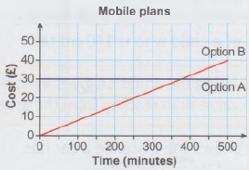
9 – Problem Solving
Page 75
Charlie can buy a pay-as-you-go mobile plan or a flat-rate mobile plan. The graph shows two different options. Both options offer unlimited data, so Charlie is considering the number of minutes he will use on calls.
Charlie thinks he will use about 300 minutes per month. If he is correct, which plan is cheaper for him to use?
How much cheaper each month would this plan be?

Slide 61
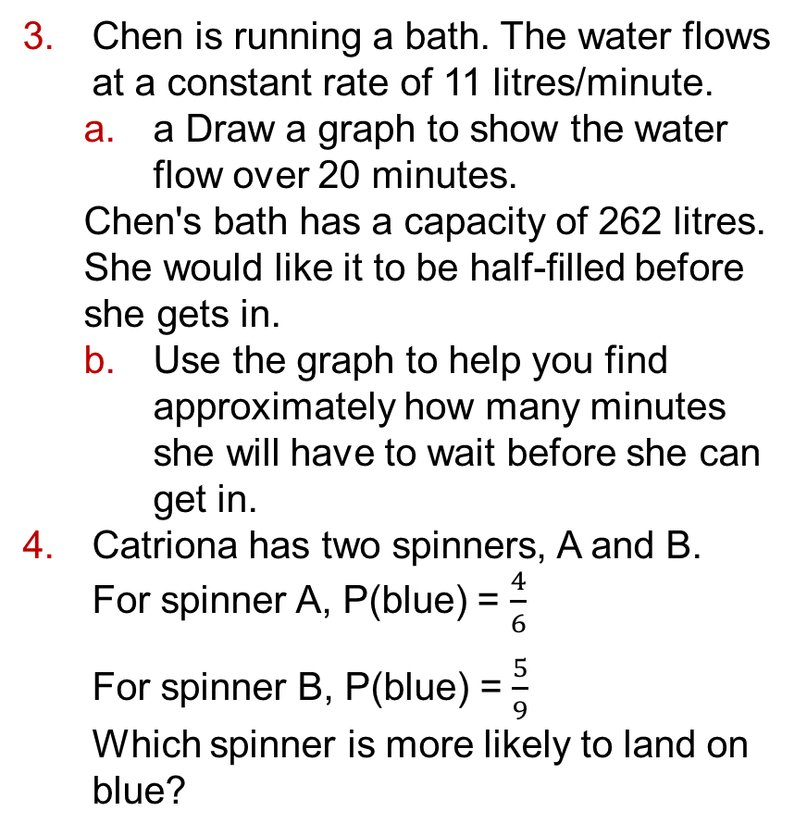
9 – Problem Solving
Page 76
Chen is running a bath. The water flows at a constant rate of 11 litres/minute.
a Draw a graph to show the water flow over 20 minutes.
Chen's bath has a capacity of 262 litres. She would like it to be half-filled before she gets in.
Use the graph to help you find approximately how many minutes she will have to wait before she can get in.
Catriona has two spinners, A and B.
For spinner A, P(blue) = $\frac{4}{6}$
For spinner B, P(blue) = $\frac{5}{9}$
Which spinner is more likely to land on blue?

Slide 62

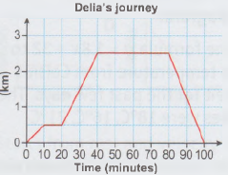
9 – Problem Solving
Page 76
Delia walks from her house to her friend Claire's house. She then walks to the shop and returns home.
How long did Delia spend at the shop?
On which part of her journey did Delia walk the fastest?
How far is the shop from Delia's house?

Slide 63
9 – Problem Solving
Page 76
The diagram shows the plan of a playground.
Lengths are in metres.
The area of the playground is 300 m2.
Write an equation and solve it to find a.
If the gate into the playground is 1.5 m wide, what length of fencing is needed to go round the rest of the playground?
12 + a
15

Slide 64
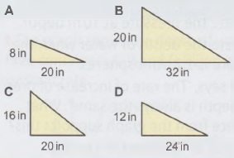
9 – Problem Solving
Page 76
R Ritu designs some mini skateboard ramps. The ramps she designs all have a gradient of 0.6 or more. Which of the ramps below could Ritu have designed?

Slide 65
9 – Problem Solving
Page 76
8 – Exam-Style Questions
Tim draws the line y = ½x + 4 on his grid. Hayley draws the line y = 2x + 4 on her grid. Tim says that if they drew the two lines on the same grid they would be parallel,
Explain why you think Tim is or is not correct.
Draw a graph to justify your answer. (4 marks)

Slide 66
9 – Problem Solving
Page 76
R Work out the missing angles.

Slide 67
9 – Problem Solving
Page 76
Kai wants to know if he will need to invest in a better advertising campaign next year.
His company managed to reach their sales target of 900 books in 2014. In 2015, their target is 1500. The table shows the total sales figures from 2009 to 2014.
Put this data into a graph.
What do you notice? Is there a trend?
Do you think Kai's company will make their) target in 2015 or not? Explain.
2009 | 2010 | 2011 | 2012 | 2013 | 2014
110 | 156 | 280 | 442 | 634 | 920

Slide 68

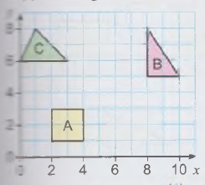

10.1 – Transformations
Page 77
Copy the diagram.
Translate shape A by (${4 \atop 2}$).
Translate shape B by (${−3 \atop 2}$).
Translate shape C by (${2 \atop −4}$).

Slide 69
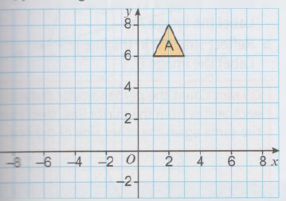

10.1 – Transformations
Page 77
Copy the diagram.
Translate shape A by each of these column lectors. Label the images B to F.
(${2 \atop 1}$) b. (${3 \atop −2}$) c. (${−6 \atop 0}$) d. (${−4 \atop −2}$) e. (${0 \atop −4}$)

Slide 70
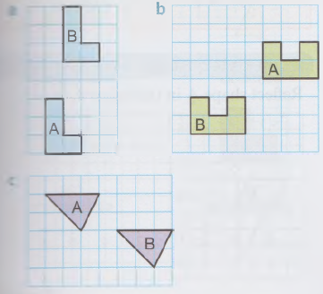
10.1 – Transformations
Page 77
Write down the column vector that translates shape A to shape B.

Slide 71
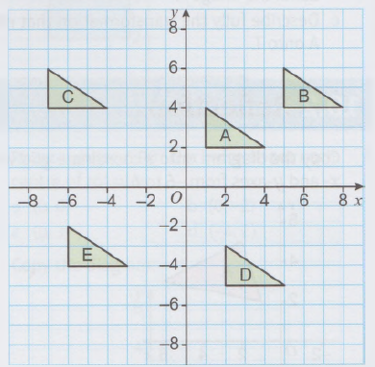
10.1 – Transformations
Page 77
Look at this diagram.
Write down the column vector that maps shape
A onto B b A onto C c A onto D
A onto E e B onto C f B onto D
E onto D.

Slide 72
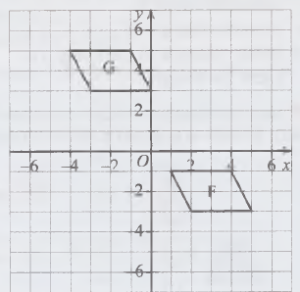
10.1 – Transformations
Page 77
5 – Exam-Style Questions
Describe fully the single transformation that maps parallelogram F onto parallelogram G.
(2 marks)
Exam hint
The first mark is for the type of transformation; the second mark is for the vector. ‘Describe fully’ means write the type of transformation (translation) and the vector

Slide 73
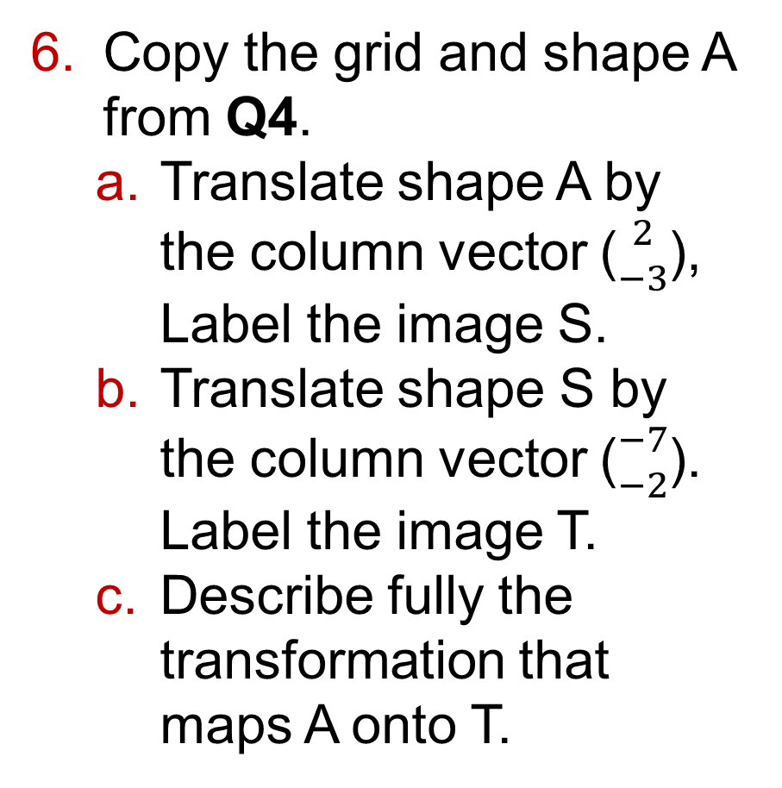
10.1 – Transformations
Page 77
Copy the grid and shape A from Q4.
Translate shape A by the column vector (${2 \atop −3}$), Label the image S.
Translate shape S by the column vector (${−7 \atop −2}$). Label the image T.
Describe fully the transformation that maps A onto T.

Slide 74
10.2 – Reflection
Page 78
Copy the diagram onto a coordinate grid with x- and y-axes from -6 to 6.
Reflect shape A in the x-axis.
Label the image B. b Reflect shape A in the y-axis.
Label the image C. c Reflect shape B in the y-axis. Label the image D.

Slide 75
10.2 – Reflection
Page 78
Copy the diagram from Q1 onto a coordinate grid with x from -8 to 8 and y from -2 to 6.
Draw the line x = -1.
Reflect shape A in the line x = -1.
Label the image X.
Draw the line y = 2.
Reflect shape A in the line y = 2.
Label the image Y.

Slide 76
10.2 – Reflection
Page 78
R Copy the diagram onto a coordinate grid with x from -6 to 8 and y from -6 to 6.
Reflect shape U in the line x = 1.
Label the image V.
Reflect shape V in the line y = -1.
Label the image W.
Jack starts with shape U and reflects it in y = -1 and then in x = 1.
Does he get the same final image?

Slide 77
10.2 – Reflection
Page 78
Copy the diagram from Q3 onto a coordinate grid with x from -6 to 8 and y from -6 to 6. Reflect shape U in the line y = 2.

Slide 78
10.2 – Reflection
Page 78
Copy the diagram onto a coordinate grid with x and y-axes from -8 to 8.
Reflect shape A in the line y = x.
Label the image A',
Reflect shape B in the line
y = -x.
Label the image B'.
Q5 hint - Count the
perpendicular
distance of each
vertex from the mirror
line, then count the
same again the other
side of the line.

Slide 79
10.2 – Reflection
Page 78
6 – Exam-Style Questions
Reflect shape A in the line y = -x.
(2 marks)

Slide 80
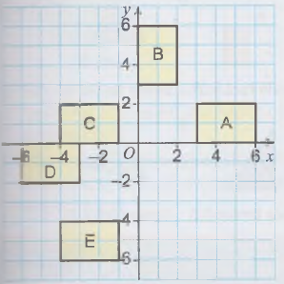
10.2 – Reflection
Page 79
R Describe fully the transformation that maps shape
A onto B b A onto C
C onto E d B onto D.

Slide 81
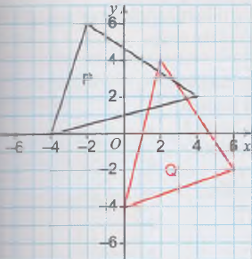
10.2 – Reflection
Page 79
R Describe fully the transformation that maps shape P onto shape Q.

Slide 82
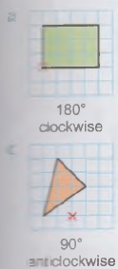

10.3 – Rotation
Page 79
Copy each diagram.
Use the centre of rotation to draw the image of each shape after the rotation given.
a
c

Slide 83
10.3 – Rotation
Page 79
Copy the diagram onto a coordinate grid with x- and y-axes from -8 to 8.
Rotate shape A 90° clockwise about each centre of rotation.
  (0,0) b (0,-2)
  (0,3) d (-4,2)

Slide 84

10.3 – Rotation
Page 79
Copy the diagram.
Rotate shape B 90° anticlockwise about (0, -4). Label the image B'.
Rotate shape C 180° clockwise about (1, -1). Label the image C'.

Slide 85
10.3 – Rotation
Page 79
R Shape V can be rotated onto shape W.
What is the direction and what is the angle of rotation?
Where is the centre of rotation?
Describe fully the transformation that maps shape V onto shape W.

Slide 86
10.3 – Rotation
Page 80
R Describe fully the transformation that maps shape
A onto B b. A onto C
A onto D d. B onto C.

Slide 87
10.3 – Rotation
Page 80
6 – Exam-Style Questions
Describe fully the single transformation that maps quadrilateral S onto quadrilateral T.
(3 marks)
Exam hint
For 3 marks you must include (1) the one type of transformation, (2) the angle and direction and (3) the coordinates of the centre of rotation.

Slide 88




10.4 – Enlargement
Page 80
Copy the diagrams.
Enlarge each shape by the scale factor.

Slide 89





10.4 – Enlargement
Page 80
Copy each diagram. Enlarge each shape by the scale factor from the centre of enlargement.
a
b
c
d
Scale Factor 2
Scale Factor 3
Scale Factor 0.5
Scale Factor 2
Q2 hint - To check your answer, draw lines from the centre of enlargement through the vertices on the original shape and across the grid. These lines should go through the vertices of the image.

Slide 90

10.4 – Enlargement
Page 80
Copy the diagram.
Enlarge shape A by scale factor 2 from the given centre of enlargement.
  (0,4) b. (1,0)

Slide 91
10.4 – Enlargement
Page 80
Copy the diagram.
Enlarge each shape by the scale factor from the centre of enlargement.
  Shape A Scale factor 2, centre (0,1)
  Shape B Scale factor 3, centre (5,-3)
  Shape C Scale factor 1½, centre (0, 9)

Slide 92
10.4 – Enlargement
Page 81
Megan enlarges this shape on her computer.
She enlarges it by 120%.
Work out the length and width of this enlargement.
She enlarges the original shape by 80%. Work out the length and width of this enlargement.
24 cm
16 cm

Slide 93
10.5 – Describing Enlargement
Page 81
Shape B is an enlargement of shape A.
Write down the scale factor of enlargement for each pair of shapes.
a
b

Slide 94
10.5 – Describing Enlargement
Page 81
R Triangle PQR is an enlargement of triangle ABC.
What is the scale factor of the enlargement?
AC = 24 cm. Work out the length of PR.

Slide 95
10.5 – Describing Enlargement
Page 81
Shape Q is an enlargement of shape P.
What is the scale factor of the enlargement?
What is the centre of enlargement?
Describe fully the enlargement that maps shape P onto shape Q.

Slide 96



10.5 – Describing Enlargement
Page 81
R Describe fully the transformation that maps shape A onto shape B.
Q4 hint - Write: enlargement, scale factor □, centre (□, □)

Slide 97

10.5 – Describing Enlargement
Page 82
5 – Exam-Style Questions
Describe fully the single transformation that maps shape J onto shape K.
(3 marks)

Slide 98
10.5 – Describing Enlargement
Page 82
R For each diagram
describe fully the transformation that maps shape A onto shape B
describe fully the transformation that maps shape B onto shape A.
a
b

Slide 99
10.6 – Combining Transformations
Page 82
Copy the grid and shape A.
Reflect shape A in the line
y = x. Label the image B.
Reflect shape B in the y-axis. Label the image C.
Describe fully the single transformation that maps shape A onto shape C.

Slide 100
10.6 – Combining Transformations
Page 82
Copy the grid and shape P from Q1.
Reflect shape P in the line x = 0.
Label the image Q.
Reflect shape Q in the line x = 4.
Label the image R.
Describe fully the single transformation that maps shape P onto shape R.
Which single transformation is the same as:
two translations
a rotation and a translation?

Slide 101
10.6 – Combining Transformations
Page 82
Copy the diagram onto a coordinate grid with x- and y-axes from -6 to 6.
Reflect shape
A in the y-axis.Label the image B.
Rotate shape B 180° about the origin (0,0). Label the image C.
Describe fully the single transformation that maps shape A onto shape C.

Slide 102
10.6 – Combining Transformations
Page 82
Copy the diagram onto a coordinate grid with x from -8 to 8 and y from 0 to 8.
Enlarge shape A by scale factor 2, centre (-6, 0). Label the image B.
Enlarge shape B by scale factor 0.5, centre (8, 4). Label the image C.
Describe fully the single transformation that maps shape A onto shape C.

Slide 103

10.6 – Combining Transformations
Page 83
5 – Exam-Style Questions
Shape J is rotated 180° about the origin to give shape K.
Shape K is translated by the vector (${−2 \atop 4}$) J to give shape L.
Describe fully the single transformation that maps shape J to shape L.
(3 marks)
Q5 hint - Draw the transformations on the grid. The origin is the point (0,0). Remember to give only one transformation.

Slide 104

10 – Problem Solving
Page 83
Solve problems using these strategies where appropriate:
Use pictures • Use smaller numbers
Use bar models • Use x for the unknown
Use flow diagrams.
1 – Exam-Style Questions
A rectangle has a length of 10 cm and a width of 2 cm. The rectangle is enlarged.
The enlarged rectangle has a width of 12 cm.
Work out the length of the enlarged rectangle. (3 marks)

Slide 105

10 – Problem Solving
Page 83
The histogram shows the amounts people spend on rent each week.
What fraction of these people spend more than £150 per week on rent?

Slide 106
10 – Problem Solving
Page 83
R This cube has surface area 541.5 cm².
What is the length of one side of the cube?
Q3 hint - Draw a flow diagram.

Slide 107
10 – Problem Solving
Page 83
R Kevin is creating a stencil to decorate his room. He uses a grid with x from -10 to 5 and y from -5 to 5 and draws a design in one of the
quadrants.
He reflects the
design in the
line y = 0.
Kevin then
reflects the
whole design in the line x = -1.
Use a grid to draw Kevin's finished design.

Slide 108

10 – Problem Solving
Page 83
Liz asked 300 people at a conference whether they came from the local area, from the UK or from overseas.
Here is some information about her results. 70 of the 140 males were from the UK.
25% of the females were from the local area. Half of all the females were from overseas.
$\frac{1}{3}$ of the total asked were from the local area.
Work out the total number of people at the conference who were from the UK.

Slide 109
10 – Problem Solving
Page 84
Ellen is creating a cartoon. She is making the buildings appear as if they are closer.
For her drawings, Ellen uses a scale factor of 2.
The top vertex of the enlarged shape is at point (6,10).
Draw the rest of the enlarged shape.
What is the centre of enlargement?
Using the same centre of enlargement, draw the next shape at a scale factor of 3 of the original drawing.

Slide 110


10 – Problem Solving
Page 84
Chris has moved the desk in his office.
The diagram shows the desk's old position. Chris rotated the desk 90° clockwise around the origin and translated it (${−4 \atop −1}$).
Copy the diagram and show the new position of the desk.

Slide 111
10 – Problem Solving
Page 84
R Fabien says that two reflections can put a shape in the same place as a single translation.
He uses a square to demonstrate.
Crystal is not sure about this and uses an arrow shape to test Fabien's theory.
What did Crystal find?
Suggest a single transformation that will put Crystal's shape in the same place as two reflections.

Slide 112


10 – Problem Solving
Page 84
Chie is creating a map for her robot. The robot starts at position A but must stop at two places (B and C) on the map. Chie writes down the column vectors for the two translations:
(${−4 \atop 2}$) for A to B and (${0 \atop −7}$) for B to C.
The diagram shows
the robot at position
C. The top left vertex
of the robot is at
(-2, -3).
Draw Chie's map on a coordinate grid to show the robot in positions A, B and C.

Slide 113
10 – Problem Solving
Page 84
Sarah is creating a design for a sequin motif on a scarf.
She has drawn a grid for her pattern and marked where to put the sequins. She has sequins at coordinates (6, 6), (5, 5), (A, 4), (4, 5), (6, 5), (6, 3), (3, 2), (3, 6) and (2, 4).
She wants to reflect the pattern in the line y = -x.
Draw the completed pattern.

Slide 114
11.1 – Writing Ratios
Page 85
Write down each ratio of blue cubes to yellow cubes.
Draw cubes to show these ratios of blue to yellow.
5 : 2 b. 2 : 3
A box of chocolates has 20 chocolates. There is 1 nut chocolate for every 4 caramel chocolates. How many chocolates are:
Nut b. Caramel

Slide 115

11.1 – Writing Ratios
Page 85
Write down ratio in its simplest form.
3 : 15 b. 12 : 6 c. 32 : 8
6 : 48 e. 15 : 25 f. 72 : 48
28 : 49 h. 36 : 42
A primary school class teacher is planning a class trip. There are 30 children in the class and 5 adults are available to go on the trip.
The guidelines say that the adult-to-child ratio should be 1: 6.
Are there enough adults for the trip?
Q4a hint -

Slide 116

11.1 – Writing Ratios
Page 85
P/R The bar charts show the numbers of rosettes won un a horse show by teams from a club.
What is the ratio of red rosettes won to other rosettes won?
Write your answer in its simplest form.
The club's trainer says that they won three times as many other rosettes as red rosettes.
Is the trainer correct?
Explain your answer.

Slide 117
11 – Writing Ratios
Page 85
Which of these ratios are equivalent?
56 : 49 b. 120 : 105
108 : 84 d. 128 : 112
63 : 49
Write each ratio in its simplest form,
6:21:15 b. 15:25:30
32:40:48 d. 45:72:54
Show that these ratios are equivalent.
15:10:35 18:12:42 36:24:84

Slide 118
11.1 – Writing Ratios
Page 85
A recipe for sweet pastry uses 200 g of flour, 100 g of butter and 75 g of sugar.
Write the ratio of flour: butter: sugar in its simplest form.
11 – Exam-Style Questions
There are 60 sweets in a bag. Of these,
18 are toffee and the rest are fruit flavoured. Write the ratio of toffee to fruit-flavoured sweets in its simplest form. (2 marks)

Slide 119

11.2 – Using Ratios 1
Page 85
The ratio of sand : cement needed to make mortar is 5:1.
Sarah uses 6 kg of cement. How many kilograms of sand
does she use?
Mark makes a model of the Burj Khalifa tower using a ratio of 1: 2400. The height of his model is 345 mm.
What is the height of the Burj Khalifa tower in metres?
Q2 hint - 1: 2400 means that 1 mm in the model represents 2400 mm in real life.

Slide 120
11.2 – Using Ratios 1
Page 86
Write each ratio as a whole number ratio in its simplest form,
0.3 : 6 b. 3.2 : 4.8
36 : 1.5 d. 14.4 : 25.6
Write each ratio as a whole number ratio in its simplest form,
0.3 : 1.25
37.8 : 6.3
12.5 : 13.75
28.8 : 61.2

Slide 121

11.2 – Using Ratios 1
Page 86
P Windows are made in standard ratios.
Type A are made in the width : height ratio of 5: 6, and Type B are made in the ratio 5: 8.
Is each of these windows Type A or Type B?
Brass screws are made from copper and zinc in the ratio 84.5 : 45.5.
Write this ratio in its simplest form.

Slide 122
11.2 – Using Ratios 1
Page 86
The ratio of fat: flour in a recipe is 3 : 8. Aziz uses 75 g of fat.
How many grams of flour should he use?
R The ratio of potato : cauliflower in a potato and cauliflower curry recipe is 9 :15.
Sanjay uses 420 g of cauliflower.
He has 300 g of potato.
Will he use all of the potato?
Huw splits his weekly pocket money into spending money and money saved to buy a laptop in the ratio 17 :13. He gets £15 each week.
How much money does he save each week?

Slide 123
11.2 – Using Ratios 1
Page 86
10 – Exam-Style Questions
A school organises a baking competition. Four classes take part. Each student can only enter one item in the competition. One class enters cakes and loaves of bread in the ratio 3:1.
There are 6 loaves of bread entered in the competition.
All the entries from the other classes are cakes.
The same number of students take part from each class.
How many students take part in the competition altogether? (4 marks)

Slide 124
11.3 – Ratios and Measures
Page 86
Write these ratios in their simplest form,
1 hour : 20 minutes
750 ml : 1 litre
8 mm : 2 m
A can contains 250 ml of cola and a bottle contains 2 litres of cola.
Write down the ratio of the amount of cola in the can to the amount of cola in the bottle. Give your answer in its simplest form.
Q1 hint - Both parts of the ratio need to be in the same units before you simplify.

Slide 125

11.3 – Ratios and Measures
Page 86
Complete these conversions,
64 000 g = □ kg
4.7 litres = □ ml
135 mm = □ cm
3.6 km = □ m
1 mile = 1.6 km. Convert
8 km to miles
62 miles to km.
The distance from Paris to Brussels by car is 305 km. How far is this in miles?

Slide 126
11.3 – Ratios and Measures
Page 86
A recipe needs 1½ pints of milk.
1 pint = 20 fl. oz (fluid ounces).
Convert 1½ pints to fluid ounces.
1 fl. oz = 28 ml. Convert your answer to part a into millilitres.
6 – Exam-Style Questions
A farm shop has 30 hundredweight of potatoes.
They need to be put into 5 kg bags to be sold.
The farm shop manager knows that
1 hundredweight ≈ 112 pounds
1 pound ≈ 0.454 kilogram
How many bags of potatoes will the farm shop have for sale? (4 marks)

Slide 127
11.3 – Ratios and Measures
Page 87
On the day that David buys some euros for this holiday, £1 buys €1.27.
How many euros does he get for £400?
Choose an
amount in £
from the cloud.
Choose an
exchange rate
from the table
.
Work out how much money you will get.
Repeat for two more amounts and currencies.
Currency | £1
Euros | 1.27
Turkish Lira | 3.56
Croatian Kuna | 9.71
Albanian Lek | 176.22
Tunisian Dinar | 2.90
Moroccan Dirham | 14.06

Slide 128

11.3 – Ratios and Measures
Page 87
P Use the table in Q8.
How many £ does Vicky get for 500 Turkish lira?
Which is worth more, 500 Moroccan dirham or 3800 Croatian kuna?
P The diagram shows two right-angled triangles.
Write these ratios in their simplest form.
The base of triangle A to triangle B.
The height of triangle A to triangle B.
The area of triangle A to triangle B.

Slide 129

11.3 – Ratios and Measures
Page 87
The diagram shows two cuboids.
Write these ratios in their simplest form,
Height of A to height of B.
Area of the darker shaded face of A to area of the darker shaded face of B.
Volume of A to volume of B.

Slide 130

11.3 – Ratios and Measures
Page 87
A pencil case contains just 4 pens and 9 pencils,
What is the ratio of pens: pencils?
What fraction of the contents of the pencil case are pens?
What fraction of the contents of the pencil case are pencils?
Rina school drama group, $\frac{3}{4}$ of the group are girls and the rest are boys.
What is the ratio of boys: girls in the group?
Rashid thinks there are 27 students in the group. Explain why he must be wrong.

Slide 131

11.3 – Ratios and Measures
Page 87
In a multipack of crisps, $\frac{3}{5}$ of the packets of crisps are salt and vinegar and $\frac{2}{5}$ of the packets are cheese and onion.
What is the ratio of salt and vinegar: cheese and onion?
There are 6 packets of cheese and onion in the multipack. How many packets of salt and vinegar are there?
How many packets of crisps are in the multipack altogether?

Slide 132

11.4 – Using Ratios 2
Page 87
Share these amounts
in the ratios given.
24 kg in the ratio 3 : 1
72 m in the ratio 1 : 5
£32 in the ratio 5 : 3
£250 in the ratio 3 : 7
42 litres in the ratio 5 : 2
12.5 km in the ratio 3 : 2
Solder used for joining metal pipes is made from a mixture of tin and lead in the ratio 3 : 2. Paul has 425 g of solder.
What is the mass of
tin b. lead?

Slide 133
11.4 – Using Ratios 2
Page 88
Green dye is mixed from yellow dye and blue dye in the ratio 3 : 4.
Amir needs 35 litres of green dye.
How many litres of yellow dye should he use?
How many litres of blue dye should he use?
A cereal mix is made from oats, wheat and barley in the ratio
3 : 2 : 1.
Chantal wants to make 600 g of cereal mix. How much of each type of ingredient does she need?

Slide 134
11.4 – Using Ratios 2
Page 88
5 – Exam-Style Questions
Jamila is going to make some shortbread.
She needs to mix flour, butter and sugar in the ratio 3 : 2 : 1 by weight.
Jamila wants to make 1.5 kg of shortbread. She has
450 g of butter
1500 g of flour
500 g of sugar
Does Jamila have enough flour, butter and sugar to make the shortbread? (4 marks)

Slide 135
11.4 – Using Ratios 2
Page 88
Share these amounts in the ratios given,
750 g in the ratio 2:3:5
600 ml in the ratio 3:2:7
£84 in the ratio 3:5:6
£30 in the ratio 4:5:3
Share these amounts in the ratios given. Round your answers sensibly.
£60 in the ratio 3 : 4
125 g in the ratio 5 : 4

Slide 136

11.4 – Using Ratios 2
Page 88
R Jennifer and Tom buy a flat to rent out for £125 000.
Jennifer pays £75 000 and Tom pays £50 000. They rent out the flat for £650 per month.
Write the amounts they each pay as a ratio.
Write the ratio in its simplest form,
Divide the rent in this ratio. How much of the rent does each of them get?
Q8b hint –

Slide 137
11.4 – Using Ratios 2
Page 88
P Kamal and Aisha buy a car together for £6300.
Aisha pays £2700 and Kamal pays £3600. They sell the car 4 years later for £4200.
How should they share the money fairly?
P / R Two whole numbers are in the ratio 2 : 5 and their product is a multiple of 3. What are the smallest numbers possible?

Slide 138
11.4 – Using Ratios 2
Page 88
Sharon and Jo share £90 in the ratio 7 : 5.
How much do they each receive?
How much more does Sharon get than Jo?
12 – Exam-Style Questions
Kevin and Lesley share a bag of sweets in the ratio 3 : 4
Kevin gets 15 fewer sweets than Lesley. How many sweets did Lesley get? (3 marks)

Slide 139


11.5 – Comparing Using Ratios
Page 88
In a karate class $\frac{4}{9}$ of the group are men and the rest are women.
What is the ratio of men to women in the class?
Copy and complete the table for different groups of people having karate lessons.
Fraction of group that are men | Ration of men : women
$$\frac{3}{7}$$
 | 5 : 3
$$\frac{11}{12}$$
 | 5 : 6

Slide 140

11.5 – Comparing Using Ratios
Page 88
In a particular fruit juice mix, $\frac{5}{12}$ is orange juice, $\frac{4}{12}$ is mango juice and the rest is apple juice.
Work out the ratio of
orange juice : mango juice: apple juice.
A car windscreen washer mix can be made from water and concentrate in the ratio 5:1. What fraction of the washer mix is
water
concentrate?

Slide 141
11.5 – Comparing Using Ratios
Page 89
Mark and Jon share a pizza in the ratio 5 : 4. What fraction of the pizza should
  Jon get
  Mark get?
Gilding brass is made of copper and zinc in the ratio 19 :1.
What fraction of the brass is
copper
zinc?

Slide 142



11.5 – Comparing Using Ratios
Page 89
The ratio of boys to girls in a music club is 3:7.
Curtis says that $\frac{3}{7}$ of the club members are boys.
Is he correct? Explain your answer.
Copy and complete to write these as unit ratios.

Slide 143
11.5 – Comparing Using Ratios
Page 89
R Fruit cookies are made by mixing flour, butter, sugar and dried fruit in the ratio 3:2:1:1.
  What fraction of the cookie mix is
    flour ii butter?
  In 700 g of cookie mix, what are the masses of flour, butter, sugar and dried fruit?
  Joyce has plenty of flour and dried fruit, but only 150 g of butter and 200 g of sugar, What is the maximum amount of cookie mix she can make?
  Show your working clearly.

Slide 144
11.5 – Comparing Using Ratios
Page 89
R A building mix uses cement, lime, building send and gravel in the ratio 1.5 :1.5: 5 : 2 s .
  What fraction of the mix is lime?
  In 50 kg of the mix, what are the masses of cement, lime, building sand and gravel?
  You have plenty of cement, gravel and lime, but only 22.5 kg of building sand, what is the maximum amount of the building mix you can make?
Q9 hint - Write the ratio with whole numbers first.

Slide 145
11.5 – Comparing Using Ratios
Page 89
Write each of these in the form m:1.
Give each answer to a maximum of 2 decimal places,
  11:4 b. 17:3
  56:15 d. 3:16
  7:32 f. 23:60
R Millie and Hannah are
dyeing T-shirts.
Millie makes an orange dye by mixing 75 g of yellow dye with 25 g of red dye.
Hannah mixes 60 g of yellow dye with 24 g of red dye for her orange dye. Whose dye is darker orange?
Explain your answer.

Slide 146
11.5 – Comparing Using Ratios
Page 89
R Liam makes wallpaper paste by mixing 230 g of glue with 8 litres of water.
Ryan makes some more wallpaper paste by mixing 95 g of glue with 3500 ml of water. Who makes the stronger paste?
Explain your answer.
R Nadya makes a recipe that uses flour to butter in the ratio 500:190.
Karl makes a different recipe using flour to butter in the ratio 425 :150.
Whose recipe has the higher proportion of butter?

Slide 147

11.5 – Comparing Using Ratios
Page 89
R Tina and Gareth are running a marathon. Tina runs for 4 hours 45 minutes and walks for 45 minutes.
Gareth runs for 5 hours 15 minutes and walks for 75 minutes.
Who walks for a higher proportion of their race time?
Explain your answer.
16 – Exam-Style Questions
A paint mixture is $\frac{4}{7}$ blue and $\frac{3}{7}$ red.
Jack says, ‘The amount of blue is one and a third times the amount of red.’
Is he correct? Explain your answer.
(3 marks)

Slide 148
11.6 – Using Proportion
Page 90
6 apples cost £1.50.
What is the cost of
  12 apples b. 2 apples
  4 apples d. 10 apples?
4 tickets to a show cost £80.
How much will 17 tickets cost?
60 litres of compost cost £4.50.
What do 84 litres cost?

Slide 149
11.6 – Using Proportion
Page 90
Edward gets £43.05 for 7 hours of work.
How much will he get for working for
  12 hours b. 25 hours
  35 hours?
R A group of 14 friends want to go on holiday together. The total cost of the holiday is £2996 and they all pay the same amount.
3 more friends agree to join them.
What is the total cost of the holiday now?

Slide 150


11.6 – Using Proportion
Page 90
R Ketchup bottles
come in two sizes.
  Copy and
  complete to find
  the unit ratios.
  Which size is the better buy?
Q6b hint - Which gives more grams for £1?

Slide 151
11.6 – Using Proportion
Page 90
R Kasia can buy bottles of cola in two sizes: a 1.25-litre bottle for £1.55 or a 1.75-litre bottle for £1.85.
Which is better value for money?
R Ajay can buy bags of rice in two sizes:
1.5 kg for £3.27 or 600 g for £1.32.
Which is better value for money?

Slide 152
11.6 – Using Proportion
Page 90
R Tom and Fred are both house painters.
Tom charges £146.10 labour for a job that takes 6 hours.
Fred charges £262.90 labour for a job that takes 11 hours.
Who will earn more for a job that takes 17 hours?

Slide 153
11.6 – Using Proportion
Page 90
10 – Exam-Style Questions
Jill is making cupcakes. She finds out the prices of cupcake cases from two companies, Bake Rite and Kitchen Plus.
She needs 240 cupcake cases and wants to buy them as cheaply as possible.
Which company should Jill buy the cupcake cases from? You must explain your answer. (4 marks)
Kitchen Plus
Pack of 60 cupcake cases £2.25
Bake Rite
Pack of 80 cupcake cases £2.89

Slide 154

11.7 – Proportion and Graphs
Page 90
Look at the graph.
Are kilograms and pounds in direct proportion?
Explain your answer.

Slide 155
11.7 – Proportion and Graphs
Page 90
The table shows some amounts of liquid in litres and in pints.
  Plot a line graph for these values,
  Are litres and pints in direct proportion?
  Explain your answer,
  Car oil is sold in a 5-litre can.
  How many pints is this?
Litres | 2 | 4 | 6 | 10
Pints | 3.5 | 7 | 10.5 | 17.5

Slide 156
11.7 – Proportion and Graphs
Page 91
The table shows the price of nails at a DIY store.
  Plot a line graph for these values,
  Is the price of the nails in direct proportion to the mass? Explain your answer.
Mass of nails (kg) | 0.5 | 1 | 2 | 5
Price of nails (£) | 1.20 | 2.40 | 5.80 | 12

Slide 157

11.7 – Proportion and Graphs
Page 91
This line graph shows the price of petrol by volume.
  Are price and volume in direct proportion?
  Work out the gradient of the line.
  How much does 1 litre of petrol cost?

Slide 158
11.7 – Proportion and Graphs
Page 91
R Which of these are in direct proportion?
Give reasons for your answers.
  Miles and kilometres
  Age and number of pets
  Litres and millilitres
  Number of people at a bus stop and time of day
P An electrician charges a callout fee of £35 plus £42 per hour she works.
Is her total charge (C) in direct proportion to the number of hours (h) she works?

Slide 159
11.7 – Proportion and Graphs
Page 91
Which of these sketch graphs show one .enable in direct proportion to the other?

Slide 160
11.7 – Proportion and Graphs
Page 91
The table shows the amount paid for different size containers of milk.
  Draw the graph,
  Work out the equation of the line.
  Are C and n in direct proportion?
  Write a formula linking the number of litres (n) and the cost (C).
  Use the formula to work out the cost of 3.6 litres of milk.
Number of litres, n | 0.6 | 1 | 1.2 | 2 | 2.4
Cost, C (p) | 48 | 80 | 96 | 160 | 192

Slide 161
11.7 – Proportion and Graphs
Page 91
Look back at the graph in Q1.
  Write the ratio kilograms: pounds in its simplest form.
  Work out the gradient of the graph.
  Write a formula that links kilograms (K) and pounds (P).

Slide 162
11.7 – Proportion and Graphs
Page 91
On a particular day, the ratio of GB pounds to US dollars is 5 : 9.
  Copy and complete this table of values for pounds and dollars.
  Draw a conversion graph for pounds to dollars.
  Write 5 : 9 as a unit ratio.
  Write a formula linking dollars (y) and pounds (x).
GB pounds (£) | 0 | 5 | 10
US Dollars ($)

Slide 163
11.7 – Proportion and Graphs
Page 91
11 – Exam-Style Questions
A plumber uses a formula to work out the cost (C) of a job according to the number of hours (H) it takes. His formula is
C = 35H + 45
Is the plumber’s charge for a job in direct proportion to the amount of time it takes?
Explain your answer. (2 marks)
Exam hint
You won’t get any marks for just ‘Yes’ or ‘No’. You must write ‘Yes’ or ‘No’ because .................

Slide 164
11.8 – Proportion Problems
Page 92
3 children build a giant sandcastle in 4 hours.
How long will it take
  1 child b. 5 children?
2 decorators take 5j hours to paint 3 rooms. How long will it take
  3 decorators
  5 decorators?
  Give your answers in hours and minutes.
Q1a hint - Will it take 1 child more or less time than 3 children?

Slide 165
11.8 – Proportion Problems
Page 92
3 school uniform shirts cost £13.50.
How much will 5 shirts cost?
R A farmer needs to pick his 750 kg crop of strawberries.
He wants all the work done in 8 hours or less. He knows that 1 person can pick 8 kg of strawberries in an hour.
How many people does he need to do the job?
A group of 5 cyclists can complete a circular 20-mile cycle in 2 hours.
How long will it take a group of 8 cyclists to complete the same ride?

Slide 166
11.8 – Proportion Problems
Page 92
It takes 25 minutes for 24 cupcakes to cool. How long will it take for 32 cupcakes?
R A farmer has enough bales of silage to feed 120 cattle for 30 days.
He sells 30 cattle.
How many days will the silage last for?
A print run of 40 exam papers uses 560 sheets of paper.
How many sheets of paper would be needed to print 215 copies of the same exam paper?

Slide 167
11.8 – Proportion Problems
Page 92
R A caretaker needs to clean 35 classrooms. He knows that 2 people can clean a room in 20 minutes.
He needs all the work to be done in 3 hours after school.
How many cleaners does he need to employ?
R It costs £85.82 to hire a car for 7 days. There is no standing charge.
How many days does Amit hire a car for if he pays £208.42?

Slide 168
11.8 – Proportion Problems
Page 92
R It takes 6 people 5 hours to pick 600 kg of apples.
The apple grower employs 2 more people.
How long will it take to pick 600 kg of apples now?
11 – Exam-Style Questions
It takes 7 men 4 hours to dig a ditch.
How long would it take 5 men?
(2 marks)

Slide 169

11 – Problem Solving
Page 92
Solve problems using these strategies where appropriate:
Use pictures
Use smaller numbers
Use bar models
Use x for the unknown
Use a flow diagram
Use more bar models.
Jay, Alix and Cam have dinner.
The total bill is £40.
Jay has only a starter. He pays one tenth of the bill.
Cam has extra drinks. She pays half of the bill.
  How much does Jay pay?
  How much does Alix pay?
  What is the ratio of Alix's bill to Cam's bill? Write your answer in its simplest form.

Slide 170
11 – Problem Solving
Page 92
Ajesh has 8 box sets of his favourite drama. He stacks them in a pile next to 20 DVDs. Both piles are the same height,
  What is the ratio of the number of box se to DVDs?
  Write your answer in its simplest form.
  One DVD is about 1.4 cm thick.
  How thick is each box set?
A group of 6 students takes 3 days to paint a classroom.
A group of 4 students takes 4 days to paint identical classroom.
Do the students in the first group work fast than the students in the second group?

Slide 171
11 – Problem Solving
Page 93
R Ms. Chapman wants to hire minibuses for a Year 8 trip to the museum.
The teacher: student ratio must be at least 1:12 on each minibus.
60 students are going on the trip.
Each minibus seats 26 people,
  What is the lowest number of teachers needed?
  How many minibuses will be needed?
  How many spare seats will there be?

Slide 172

11 – Problem Solving
Page 93
R 3 bags, A, B and C, contain different amounts of money.
The amount in bag B is $\frac{3}{5}$ of the amount In bag A. The amount in bag C is $\frac{1}{4}$ of the amount in bag B.
  There is £60 in bag A.
  How much money is in bags B and C?
  What is the ratio A: C in its simplest form?
  Would the ratio be different if bag A contained £80? Explain your answer.

Slide 173
11 – Problem Solving
Page 93
R All the sweets in a packet are either cubes or spheres. The ratio of cubes to spheres is 3 : 5.
  How many sweets could be in the bag?
  What is the smallest number possible?
  The sweets have either blue wrappers or yellow wrappers. The ratio of blue to yellow wrappers is 5:7.
  What is the smallest number of sweets possible now?
  With the number of sweets found in part b, how many of each type are there?
Q6b hint - You need a number that works for both ratios. Draw bar models to help you.

Slide 174
11 – Problem Solving
Page 93
R Two of the angles in a quadrilateral are 60° and 90°.
The other two angles are in the ratio 3:4.
  What are the missing angles?
  There are two different types of quadrilateral with these angles.
  What are they?
The first term in a sequence is n.
The term-to-term rule is x4 - 2 The fourth term is 22.
What is n?

Slide 175
11 – Problem Solving
Page 93
R Kirti places a 1 kg bag of sugar on her faulty scales. It reads 1.2 kg. She then places a 5 kg bag of rice on it. It reads 6 kg.
  What is the ratio of real weight to faulty reading of the scales?
  A recipe requires 800 g of flour.
  What do the scales need to show for Kirti to weigh out the correct amount?

Slide 176

11 – Problem Solving
Page 93
Last year, Devan, Nikhil and Jasdeep shared their company profits in the following way. Devan got $\frac{9}{20}$ Nikhil got $\frac{3}{10}$ and Jasdeep got the rest.
This year they are splitting their profits in the ratio 5:4:3.
In both years the company's profit was £180 840.
  Nikhil is happy with the change. Explain why.
  Using fractions, show that the change did not make a difference to Jasdeep.

Slide 177
11 – Problem Solving
Page 93
11 – Exam-Style Questions
At St Andrew’s High there are 160 Year 11 students.
65% of them will be staying on to attend the sixth form college.
Of those staying on, the ratio of boys to girls is 6:7
Of those leaving at the end of the year, the ratio of boys to girls is 5:2
How many more boys are staying on than leaving? (5 marks)

Slide 178

12.1 – Pythagoras’ Theorem 1
Page 94
a. Draw each triangle on centimeter squared paper.
  i. Measure the length of the unknown side.
  ii What is the length of the hypotenuse?

Slide 179

12.1 – Pythagoras’ Theorem 1
Page 94
Write the length of the hypotenuse for each of these triangles.

Slide 180

12.1 – Pythagoras’ Theorem 1
Page 94
A square is drawn on each side of a right-angled triangle,
  Check that the measurements match your answer to Q1a.
  Find the area of each square,
  Copy and complete:
  □²= 9² + 12²

Slide 181

12.1 – Pythagoras’ Theorem 1
Page 94
R Copy and complete this statement:
c² = □² + b²
P A ramp is to be installed in a skate park. The ramp will rise 0.5 m over a distance of A m and forms a right-angled triangle. How long must the ramp be?
Give your answer to the nearest cm.

Slide 182


12.1 – Pythagoras’ Theorem 1
Page 94
Calculate the length of
the hypotenuse, x, in
each right-angled
triangle.
Give your answers correct to 3 s.f.

Slide 183

12.1 – Pythagoras’ Theorem 1
Page 94
Calculate the length of BC in each right-angled triangle.
Give your answers correct to 2 s.f.

Slide 184

12.1 – Pythagoras’ Theorem 1
Page 94
8 – Exam-Style Questions
ABCD is a rectangle.
Work out the length of AC.
Give your answer to 3 significant figures. (4 marks)

Slide 185

12.1 – Pythagoras’ Theorem 1
Page 95
9 – Exam-Style Questions
An envelope measures 6 cm by 8 cm The flap meets the envelope at the point M. The point M is in the exact centre of the envelope.
A glue strip runs from D to M and M to C.
What is the length of the glue strip?
(4 marks)

Slide 186

12.2 – Pythagoras’ Theorem 2
Page 95
Are these numbers surds?
  $\sqrt{lOO}$ b. $\sqrt{5}$
  $\sqrt{l}$ d. $\sqrt{7}$
  $\sqrt{l44}$ f. $\sqrt{lO}$
Simplify these expressions.
Give each answer as a surd.
  $\sqrt{22+52}$
  $\sqrt{12+32}$
  $\sqrt{42−22}$

Slide 187
12.2 – Pythagoras’ Theorem 2
Page 95
P The points A(1, 7) and B(4, 2) are shown on a centimetre square grid.
Work out the length in centimetres of AB. Give your answer correct to 3 s.f.

Slide 188

12.2 – Pythagoras’ Theorem 2
Page 95
P A helicopter flies from a lighthouse to a ship. Calculate the distance it flies.
The points are marked on a mile square grid.

Slide 189
12.2 – Pythagoras’ Theorem 2
Page 95
The points A and B are plotted on a centimetre square grid.
For each set of points, calculate the length of AB.
  A(l, 1) and B(9, 2)
  A(3, 8) and B(-2, 5)
  A(10,-4) and B(3, 0)

Slide 190
12.2 – Pythagoras’ Theorem 2
Page 95
6 – Exam-Style Questions
ABC is a right-angled triangle.
AB = 12.5 cm and BC = 15.7 cm. Calculate the length of AC, giving your answer to 3 significant figures. (3 marks)

Slide 191

12.2 – Pythagoras’ Theorem 2
Page 96
Work out the length of the unknown side in each right-angled triangle.
Give your answers to an appropriate degree of accuracy.
P PQRS is a square.
The diagonal
PR = 12 cm. Work
out the length of
each side of the
square.

Slide 192


12.2 – Pythagoras’ Theorem 2
Page 96
Find the length of the unknown side in each right-angled triangle.
Give your answers in surd form.
P Here are the lengths of sides of triangles. Which of these triangles are right-angled triangles?
  2 cm, 3 cm, 5 cm
  6 cm, 8 cm, 10 cm
  10 m, 24 m, 26 m

Slide 193
12.3 – Trigonometry: The Sine Ratio 1
Page 96
Copy these right-angled triangles.
For each triangle, label the hypotenuse 'hyp' and the side opposite the angle θ 'opp'.
The first has been started for you.
Use your calculator to find, correct to 3 d.p.
  Sin 45⁰
  Sin 81⁰
  Sin 18.3⁰

Slide 194

12.3 – Trigonometry: The Sine Ratio 1
Page 96
a. R Draw these triangles accurately using a ruler and protractor.
  Label the hypotenuse (hyp) and opposite side (opp).
  Measure the opposite side.
  i Write the fraction $\frac{opposite}{hypoteneuse}$ for each triangle and convert it to a decimal.
  ii What do you notice?
  iii What do you think the fraction will be for any right-angled triangle with an angle of 30°?

Slide 195
12.3 – Trigonometry: The Sine Ratio 1
Page 96
Write θ as a fraction for each triangle.

Slide 196


12.3 – Trigonometry: The Sine Ratio 1
Page 96
Find the value of x in each triangle. Give your answers correct to 1 d.p.

Slide 197
12.3 – Trigonometry: The Sine Ratio 1
Page 97
A fishing line is cast from the top of a 3 m wall. The line makes an angle of 55° with the water. How long is the fishing line?

Slide 198

12.3 – Trigonometry: The Sine Ratio 1
Page 97
7 – Exam-Style Questions
ABCD is a rectangle. The diagonal BD is drawn and makes an angle of 33° with the line CD.
Given that BC = 5 cm work out the length of BD. (2 marks)

Slide 199

12.3 – Trigonometry: The Sine Ratio 1
Page 97
R A wheelchair ramp is set to an angle of 6° with the horizontal.
The ramp must go up a step 0.5 m high.
The ramp is 6 m long. Is it long enough?
Q6 hint - Draw a diagram to help visualise the question

Slide 200
12.4 – Trigonometry: The Sine Ratio 2
Page 97
Find angle θ. Each one is a multiple of 10°.
  sin θ = 0.766 044 4431
  sin θ = 0.984 807 753
  sin θ = 0.342 020 1433
Q1 hint - Use the key on
your calculator. You only need to try angles such as 10°, 20°, 30°,...
sin

Slide 201
12.4 – Trigonometry: The Sine Ratio 2
Page 97
Find angle θ. Each one is a multiple of 5°.
  sin θ = 0.707 106 7812
  sin θ = 0.996 194 6981
  sin θ = 0.087 155 7427
Use sin⁻¹ on your calculator to check your answers to Q1 and Q2.
The first has been started for you.
  sin θ = 0.7660444431
    θ = sin⁻¹(0.766O444431)
    θ = □

Slide 202

12.4 – Trigonometry: The Sine Ratio 2
Page 97
Use sin⁻¹ on your calculator to find the value of θ correct to 0.1°.
  sin θ = 0.678
  sin θ = 0.9214
  sin θ = 0.7777
Use your calculator to find the value of θ correct to 0.1°.
  sin θ = $\frac{5}{6}$ b. sin θ = $\frac{2}{15}$
  sin θ = $\frac{3.2}{19.8}$

Slide 203




12.4 – Trigonometry: The Sine Ratio 2
Page 97
Copy and complete these diagrams. The first one has been done for you.
P An 18 m ramp rises 1.8 m. What angle does the ramp make with the horizontal?

Slide 204
12.4 – Trigonometry: The Sine Ratio 2
Page 97
Calculate the size of angle θ in each triangle. Give your answer to an appropriate degree of accuracy.

Slide 205

12.4 – Trigonometry: The Sine Ratio 2
Page 98
14 – Exam-Style Questions
ABC is a right-angled triangle.
BC = 5 cm AC = 9 cm
Calculate the size of the angle marked x. Give your answer correct to the nearest
1 decimal place. (2 marks)

Slide 206

12.5 – Trigonometry: The Cosine Ratio
Page 98
a. R Draw these triangles accurately using a ruler and protractor.
  Label the hypotenuse (hyp) and adjacent side (adj).
  Measure the adjacent side.
  i Write the fraction $\frac{adjacent}{hypoteneuse}$ for each triangle and convert it to a decimal.
  ii What do you notice?

Slide 207

12.5 – Trigonometry: The Cosine Ratio
Page 98
Use your calculator to find, correct to 3 d.p.
  cos 30° b. cos 1°
  cos 19.5° d. cos 87°
  cos 19.5° f. cos 75°
R Use this triangle to show why cos 45° = sin 45°.

Slide 208

12.5 – Trigonometry: The Cosine Ratio
Page 98
Write cos θ as a fraction for each triangle.

Slide 209



12.5 – Trigonometry: The Cosine Ratio
Page 98
Find the value of x in each triangle. Give your answers correct to 1 d.p.

Slide 210

12.5 – Trigonometry: The Cosine Ratio
Page 98
P A man walks on a bearing of 135° from point A for 5 miles.
How far south has he travelled?
Q5 hint - Work out the angle between the south line and the direction in which the
man walks.

Slide 211

12.5 – Trigonometry: The Cosine Ratio
Page 98
Use cos⁻¹ on your calculator to find the value of 9 correct to 0.1°.
  cos θ = 0.15
  cos θ = 0.921
  cos θ = 0.12
Use your calculator to find the value of 6 correct to 0.1°.
  cos θ = $\frac{3}{7}$
  cos θ = $\frac{2}{19}$
  cos θ = $\frac{84.5}{96.1}$

Slide 212



12.5 – Trigonometry: The Cosine Ratio
Page 99
Copy and complete these diagrams.

Slide 213

12.5 – Trigonometry: The Cosine Ratio
Page 99
Calculate the size of angle θ in each of these triangles. Give your answers to 1 d.p.

Slide 214

12.5 – Trigonometry: The Cosine Ratio
Page 99
11 – Exam-Style Questions
R ST is a right-angled triangle.
ST = 12.3 cm RT = 5.8 cm
Calculate the size of the angle marked x°.
Give your answer to 1 decimal place. (3 marks)

Slide 215



12.6 – Trigonometry: The Tangent Ratio
Page 99
a. R Draw these triangles accurately using a ruler
and protractor.
  Label the opposite (opp) and adjacent side (adj).
  Measure the side marked x.
  i Write the fraction $\frac{opposite}{adjacent}$ for each triangle and convert it to a decimal.
  ii What do you notice?

Slide 216
12.6 – Trigonometry: The Tangent Ratio
Page 99
Use your calculator to find, correct to 3 d.p. where necessary
  tan 30° b. tan 46°
  tan 73° c. tan12°
  tan 85°
  tan 19.2°
Write tan θ as a
fraction for each
triangle.

Slide 217




12.6 – Trigonometry: The Tangent Ratio
Page 100
Find the value of x in each triangle. Give your answers correct to 1 d.p.

Slide 218

12.6 – Trigonometry: The Tangent Ratio
Page 100
P A ladder is leaning against a wall at an angle of 70° to the horizontal. The base of
the ladder is 1.5 m
from the wall.
How high up the wall
does the ladder
reach? Give your
answer to the
nearest cm.

Slide 219
12.6 – Trigonometry: The Tangent Ratio
Page 100
Which angle is an angle of elevation, and which is an angle of depression?

Slide 220

12.6 – Trigonometry: The Tangent Ratio
Page 100
P The angle of elevation of the top of a set of rugby posts, C, from the kicker's kicking tee, B, is 37°. The kicking tee is 22 metres from the base of the posts.
  Copy the diagram and label it with this information.
  How tall are the posts?
  Give your answer correct to the nearest cm.

Slide 221

12.6 – Trigonometry: The Tangent Ratio
Page 100
P From the top of a lighthouse, Mr Amesbury sees a surfer. The angle of depression from Mr Amesbury to the surfer is 40°. The lighthouse is 60 m above sea level.
How far from the base of the lighthouse is the surfer?
Use tan⁻¹ on your calculator to find the value of θ correct to 0.1°.
  tan θ = 0.91 b. tan θ =1.49
  tan θ = $\frac{11}{5}$ d. tan θ = $\frac{0.9}{0.77}$

Slide 222



12.6 – Trigonometry: The Tangent Ratio
Page 100
Copy and complete these diagrams.

Slide 223

12.6 – Trigonometry: The Tangent Ratio
Page 100
Calculate the size of the angle θ in each of these triangles.

Slide 224

12.6 – Trigonometry: The Tangent Ratio
Page 100
12 – Exam-Style Questions
ABC is a right-angles triangle.
AB = 19.5 cm
BC = 24 cm
Calculate the size of the angle marked y. Give your answer to 1 decimal place.
(3 marks)

Slide 225





12.7 – Finding Lengths and Angles using Trigonometry
Page 101
Calculate the value of x in each triangle. Give your answers correct to 3 s.f.

Slide 226
12.7 – Finding Lengths and Angles using Trigonometry
Page 101
Calculate the size of angle x in each of these triangles.

Slide 227

12.7 – Finding Lengths and Angles using Trigonometry
Page 101
3 – Exam-Style Questions
ABC is a right-angled triangle. AC = 4 cm
BC = 12 cm
Work out the size of angle ACB.
Give your answer correct to 1 decimal place. (3 marks)

Slide 228
12.7 – Finding Lengths and Angles using Trigonometry
Page 101
P The Eiffel Tower is 301 m tall. A man stands 40 m from the base of the tower and looks at the top.
Find the angle of elevation of his sight line.
P A diver spots a ship wreck from the surface of the water. The angle of depression is 47°. The water is 50 m deep.
How far will he have to swim on the surface until he is directly over the wreck?

Slide 229

12.7 – Finding Lengths and Angles using Trigonometry
Page 101
R Triangle ABC is an equilateral triangle with side length 2.
Work out
  i sin 30°
  ii cos 30°
  iii tan 30°
  i sin 60°
  ii cos 60°
  iii tan 60°
  Express your answers as fractions, using surds when necessary.

Slide 230

12.7 – Finding Lengths and Angles using Trigonometry
Page 101
R Triangle PQR is a right-angled isosceles triangle. PQ and PR have length 1.
Work out
  sin 45°
  cos 45°
  tan 45°
  Express your answers as fractions, using surds when necessary.

Slide 231


12.7 – Finding Lengths and Angles using Trigonometry
Page 101
Using your answers to Q6 and Q7, find the lengths of the sides marked with letters.

Slide 232

12.7 – Finding Lengths and Angles using Trigonometry
Page 101
R Triangle
ACD is
equilateral
with sides of
length 2 cm.
Work out the
length of BD.
A vertical tent pole is 2.2 m high. The guy rope for the pole is tied to a peg 2.2 m from the bottom of the pole.
What is the angle of elevation from the tent peg to the top of the pole?

Slide 233
12 – Problem Solving
Page 102
Solve problems using these strategies where appropriate:
Use pictures
Use smaller numbers
Use x for the unknown
Use flow diagrams and bar models
Use formulae.
Photograph A has a length of 8 cm and a height of 6 cm. Photograph B has a length of 15 cm and a height of 11 cm. Photograph C is an enlarged copy of photograph A and has a height of 18 cm.
  How much longer is photograph C than photograph B?
  What is the scale factor of enlargement from A to C?

Slide 234
12 – Problem Solving
Page 102
There are 168 students in Year 9.
The students can choose to study either French or German. The ratio for choice of French : German is 5: 3. Class sizes can be a maximum of 30 students. How many classes are needed for the students studying French?
The lengths of the sides of four triangles are given below in cm to 1 decimal place. Which of these triangles are right-angled triangles?
  8.5, 11.0, 13.9
  74.0, 120.0, 135.0
  22.4, 15.5, 27.2
  14.7, 7.2, 15.5
Q3 hint - Arrange the information in a table to see it more clearly..

Slide 235
12 – Problem Solving
Page 102
R Jabina's allotment is in the shape of a right- angled triangle. She is putting up a fence on all three sides of the allotment. The two short sides are 14.4 m and 8.5 m in length. If fencing is sold in whole numbers of metres only, what length of fencing should Jabina buy to have the smallest amount left over?
R Johan needs to fix a window at the front of a hotel. The window is located about 7 metres from the ground. To avoid the hotel door frame, Johan must position the bottom of his ladder 2 metres from the front of the hotel. Is an 8 metre ladder long enough?
How do you know?

Slide 236

12 – Problem Solving
Page 102
Yan draws two line segments. The first line segment starts at (6, 2) and ends at (2, 5), and the second line segment ends at (7, 4) and starts at (3, 5). Find the coordinates of the midpoint of each line segment.
R The diagram
shows 3 paths
on a nature
walk.
  How do you know without calculating which path is the longest?
  Eagle path is about 2.4 km long and Fox path is about 7.5 km long.
  About how long is Squirrel path?
  Give your answer to 1 decimal place.

Slide 237

12 – Problem Solving
Page 102
8 – Exam-Style Questions
ABC is a right-angled triangle.
AB = 22.5 cm
BC = 12.0 cm
Work out the length AC. Give your
answer to 1 decimal place.
(3 marks)

Slide 238
12 – Problem Solving
Page 102
Paulina is putting up her tent. She has a guy rope coming from the centre pole.
The pole is 180 cm tall and the rope is 360 cm| long.
  What angle from the ground will the rope be?
  How far from the pole will the rope be pegged out to?
  Give your answer to to 1 d.p.
Satoshi is building a ramp. He has a 75 cm plank that goes up to the step. The plank ends at a distance of 60 cm from the bottom of the step.
  What is the angle of the ramp?
  Give your answer to 1 d.p.
  How high is the top of ramp above the ground?

